Slide 1

EFFECTS OF WEATHER ON ROAD ACCIDENTS
Brinda Kulkarni Mahima Modi Jerin Philip Kartik Vora

Slide 2
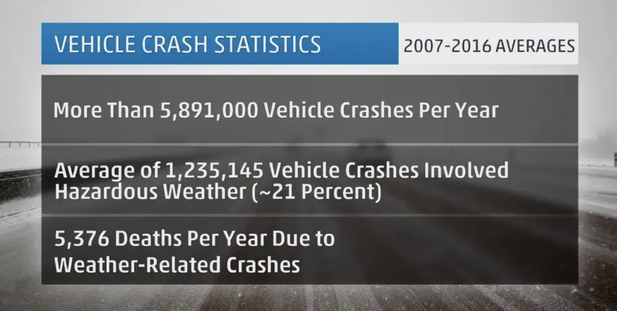
AT A GLANCE
Weather-related vehicle accidents kill more people annually than large-scale weather disasters.
Late fall through early spring, all potential driving weather hazards are in play, from rain and snow to ice and fog.
The U.S. Department of Transportation (DOT) said more than 5.8 million vehicle crashes occur each year based on statistics from 2007 to 2016.
About 21 percent of those, or just over 1.2 million, involved hazardous weather.

Slide 3
PROJECT SCOPE
What are we trying to do?
Acquire weather and accidents related information for different cities across the US
Highlight the link between weather conditions and road accident risk at an aggregate level
How are we doing it?
Web-scraping techniques
Why is it valuable?
According to the FHWA, most weather-related crashes happen on wet pavement (nearly 70 percent), while 46 percent of such accidents occur during rainfall
This shows a clear relation between weather and accidents
We hope to consolidate this data and make it easier to consume and distribute
APIs

Slide 4
USE CASES
Weather plays a very important role in our day- to-day life and we hope to find a connection between the weather and accidents due to bad weather conditions.
Our goal is to collect the data from internet and relate the two datasets to gather meaningful insights from it.
We hope our data can be useful to the society and its analysis in future may help prevent accidents.
Primary user of our data can be the government as by analyzing the data they can be prepared for road safety measures.
A timely advisory, a proactive safety approach in road repair , allocation of emergency services based on hourly condition of weather could definitely benefit everyone.

Slide 5
DATA ORIGINS
Weather data: This contains all the historical weather data and we can obtain the weather data at the time and location of the accident
Accident data-NYC: This contains the data obtained from the New York Open Data Website
Accident data-VA: This contains the data obtained from the Virginia Open Data Website
Accident data-F: This contains the data obtained from the Florida Open Data Website

Slide 6
SOURCES
NYC Open Data
https://data.cityofnewyork.us/Public-Safety/Motor-Vehicle-Collisions-Crashes/h9gi-nx95
FDOT Open data Hub
https://gis-fdot.opendata.arcgis.com/datasets/crashes-all/explore?layer=0&location=27.398575%2C-83.000000%2C6.97&showTable=true
Virginia Accidents Data
https://www.virginiaroads.org/datasets/VDOT::crash-data-1/api?layer=0
Open Weather Map
http://history.openweathermap.org/data/2.5/history/city?lat="+str(lat)+"&lon="+str(long)+"&type=hour&start="+str(time)+"&cnt=1&appid=

Slide 7
APPROACH TO ACQUIRING THE DATA
Accident data NYC was acquired using two approaches:
Web Scraping using Selenium
Directly using the API provided in the New York Open Data Website, Florida Open Data Website and Virginia Open Data Website.
Weather data was obtained by calling the OpenWeatherMap API and the generated API key
Certain websites which were used to get the crash data for different cities used AJAX calls. Hence, these sites had to be inspected manually to obtain the AJAX url which were used to obtain the dataset. We used this approach for Florida accidents data acquisition

Slide 8
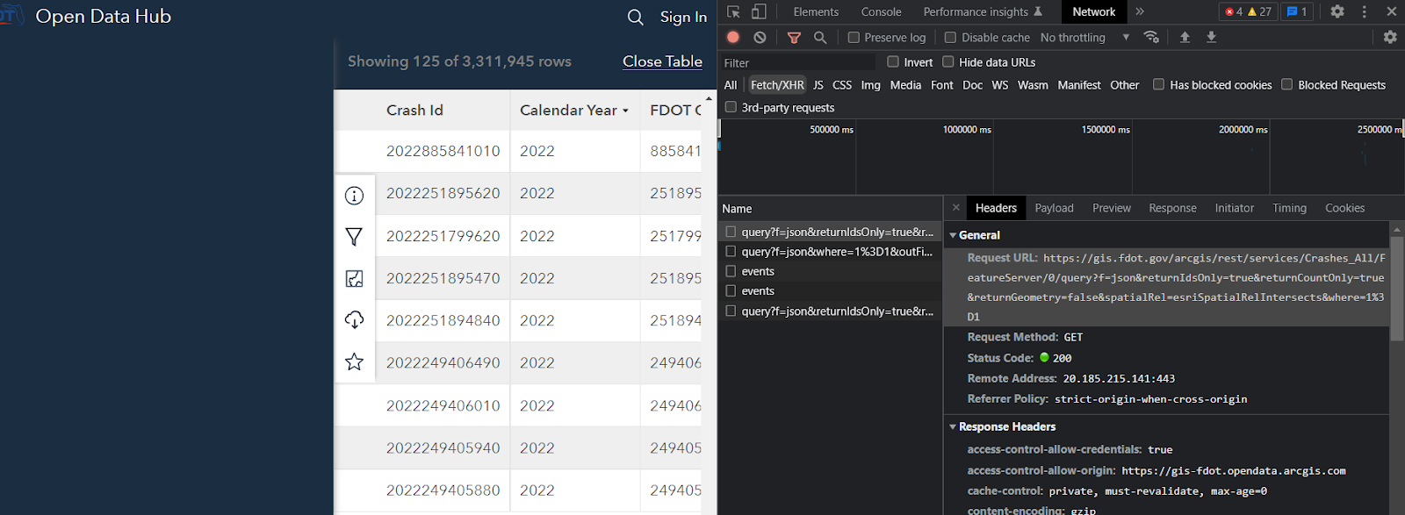
IN CASE OF DYNAMIC WEB PAGES

Slide 9
APPROACH TO PREPROCESSING DATA
For the crash dataset, a new crash_datetime of type datetime was created by combining the crash_date and crash_time columns in order to match the data from the weather API.
Unnecessary columns were removed from both the weather and crash datasets.
The rows in the data frames which didn’t have data for the latitude and longitude columns were removed.
By using geopy library, adding the city, zipcode data based on latitude and longitude

Slide 10

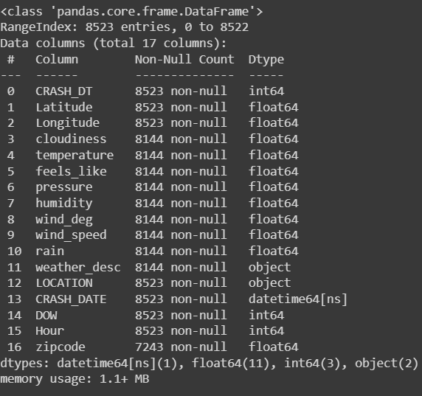
Final Dataset Information after merging with weather data

Slide 11
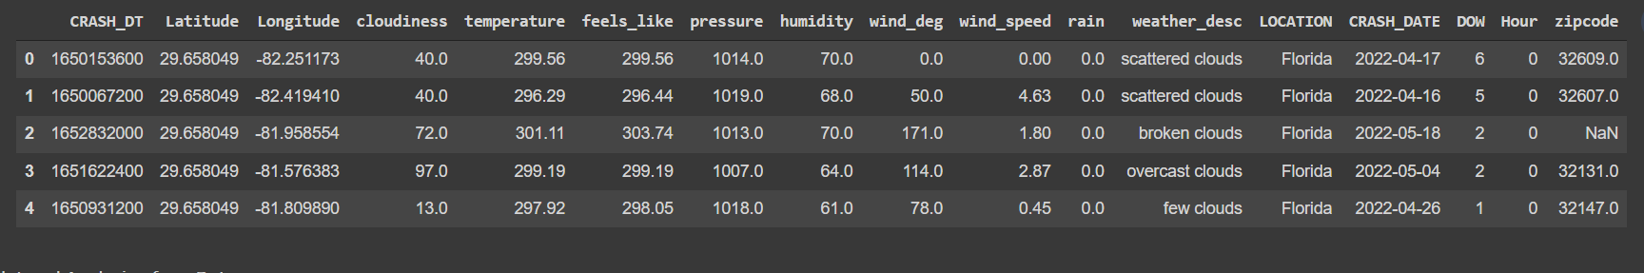
Sample Data

Slide 12
Issues and Limitations
Beautiful Soup posed a problem with data scraping as the web sites were rendered using JavaScript and jQuery. It only allowed to get one page of data.
We used Selenium Driver to get the Page wise crash data – which has issues with timeout in case the AJAX query took really long to retrieve data.
Generalizing didn’t pan out the way we wanted it to as retrieving crash data for multiple cities proved to be difficult.
Selenium didn’t work on google collab and hence had to be worked on locally.
Using the weather API posed a problem. Since a student account was used to access the data, only the past one-year data was accessible.

Slide 13

Distribution & ACCESS RIGHTs
All out dataset are publicly available via multiple ways – web scraping, APIs
This dataset does not consist of any personal/private details

Slide 14
CONTRIBUTION
Mahima and Brinda
Primarily Worked on Data Acquisition from NYC open data. Tried out to different approaches.
Scraped data using Selenium and NYC API.
Kartik and Jerin
Primarily Worked on pre-processing the crash data obtained from FL and VA.
Made necessary processing with the weather data to combine them based on the latitude, longitude and datetime attribute
We were all involved in all stages of the project. It was complete teamwork involving constant communication and sharing of ideas. Our primary goal was to learn different ways for data acquisition and by trying different libraries like – Selenium, Request-HTML (although, we did not use if for the final project), geopy, requests, beautiful soup etc., we did manage to achieve a good amount of knowledge.

Slide 15
Thank YOU

